Slide 1
Classifications of computer
Palmtop PC
Laptop Pc
Personal computer
Workstations
Mainframe
Super Computer

Slide 2
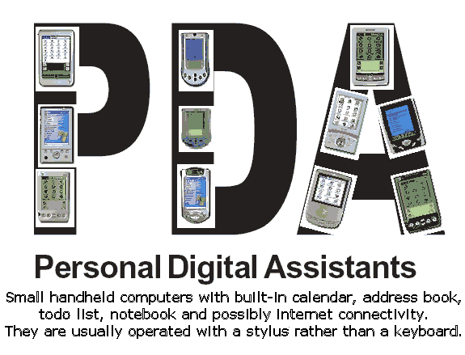
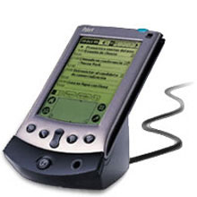
PALMTOP
(Personal Digital Assistant)
Presented by
Sweta Patel
Kisan Dhobi

Slide 3
Topics
What is a “PDA”?
INTRODUCTION.
MAJOR PLAYER OF PDA.
APPLE PDA.
DEVELOPMENT OF PDA.
FEATURES OF PDA.
STANDARD APPLICATIONS.
USES OF PDA.
LIMITATION OF PDA.
Next

Slide 4
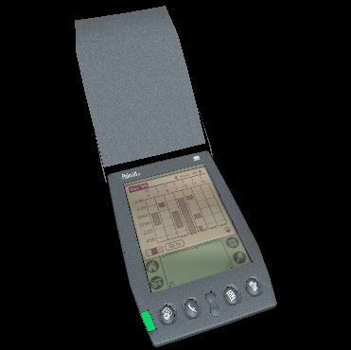
What is a “PDA”?
Personal Digital Assistant
(“Handheld computer”,
“Palm-top computer)
an organizer
a computer
portable (wireless)
pocket-sized
Next

Slide 5
MAJOR PLAYER OF PDA.
Apple Computer.
BlackBerry.
HTC Corporation.
Nokia.
Previous
Next

Slide 6

APPLE PDA.
The term PDA was first used on january,7 1992 by Apple Computer CEO John Sculley.
Previous
Next

Slide 7
PDA DETAILS
In 1996, Apple company introduced the first mobile phone with full PDA functionality, the 9000 Communicator, which grew to become the world's best-selling PDA.
The Communicator spawned a new category of mobile phones: the "PDA phone", now called "smart phone". Today, almost all PDAs are called as smart phones
        Continue….
Previous

Slide 8
Over 150 million smart phones are sold each year, while "stand-alone" PDAs without phone functionality sell only about 3 million units per year.
Previous
Next

Slide 9
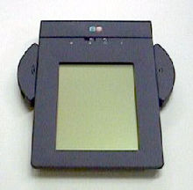
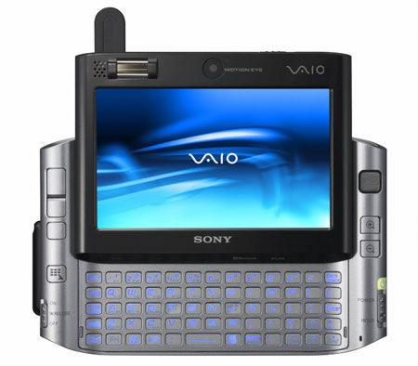
DEVELOPMENT OF PDA.
In 1992s PDA:
In 1997s PDA:
Previous
Next

Slide 10

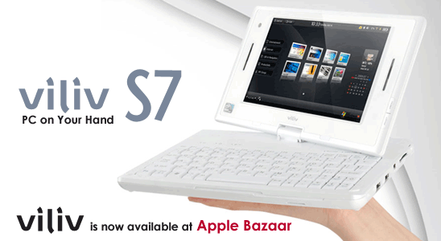
In 2009s PDA:
Todays PDA:
Previous
Next

Slide 11
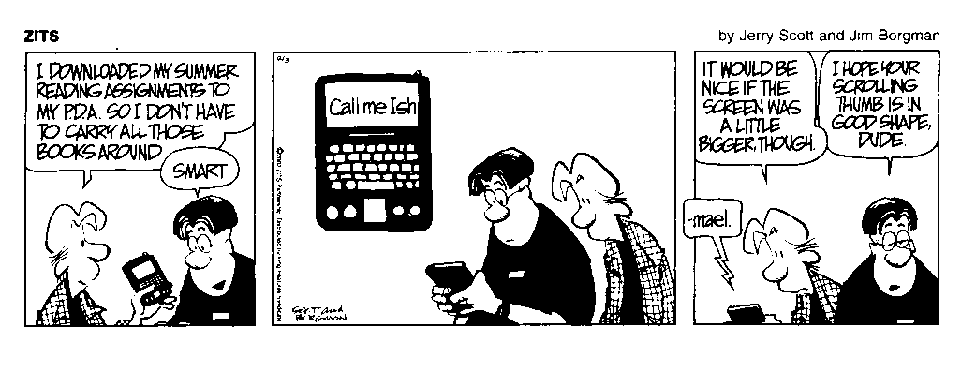
E-Books
Previous
Next

Slide 12
FEATURES OF PDA
Touch Screen:
Memory Card:
Wired Connectivity:
Wireless connectivity:
Previous
Next

Slide 13
STANDARD APPLICATIONS
Calendar (Date Book)
Memo Notepad
Address Book
Calculator
Games
Mail
Security
CityTime
Previous
Next

Slide 14
USES OF PDA.
Medical and scientific uses:
Educational uses:
Recreational uses:
Previous
Next

Slide 15
LIMITATION OF PDA
Because of their small size, most palmtop computers do not include disk drives.
Data inserting speed is slow compared to full-size computer and laptop.
It is Costly and expansive compared to computer and laptop
Previous
Next

Slide 16

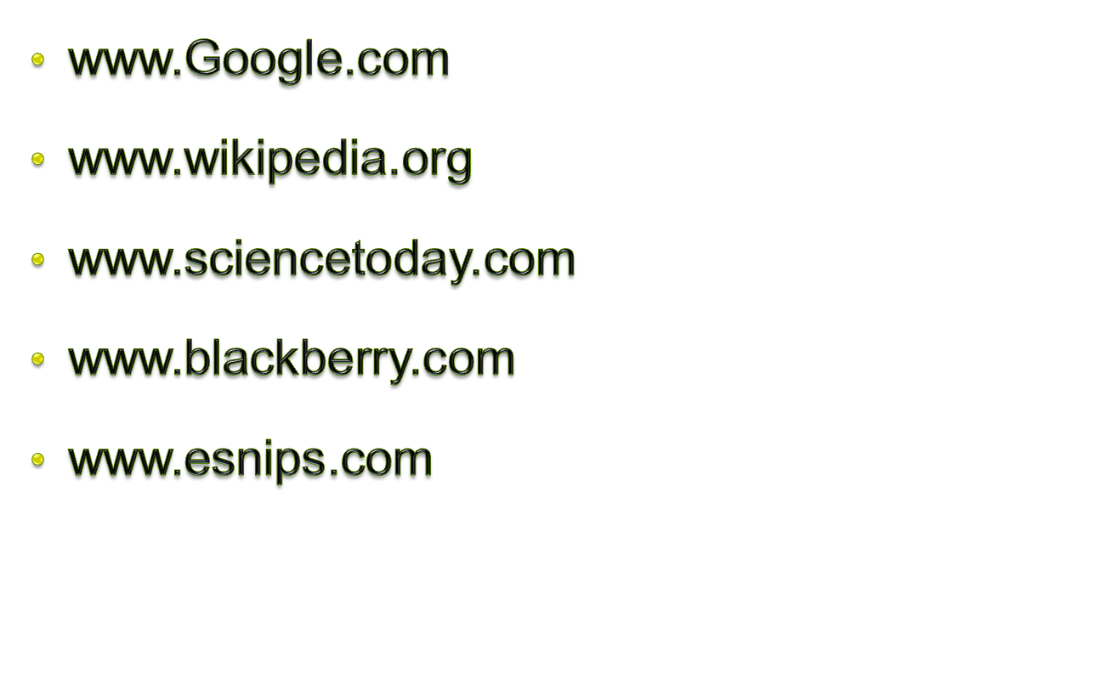
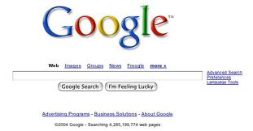

Previous
Next

Slide 17
THANK YOU
Guided by:
Selvi Mam

